Slide 1
Sustainable
When the levels or amount available is maintained over a period of time.
In other words, the amount of something available remains higher than the rate that it is being used up.
If we are running out of a resource, then it is unsustainable.

Slide 2
Describing Textures
crisp smooth silky slippery
rough uneven bumpy
scratchy glossy velvety
wooly snuggly fine thick
floaty transparent
dense heavy light

Slide 3
Distances
London to China
London to India
London to Berlin
South Korea to London
London to Taiwan
Milan to London
London to Nottingham
New York to London
4868 miles
4649 miles
679 miles
5621 miles
6134 miles
766 miles
127 miles
3459 miles

Slide 4
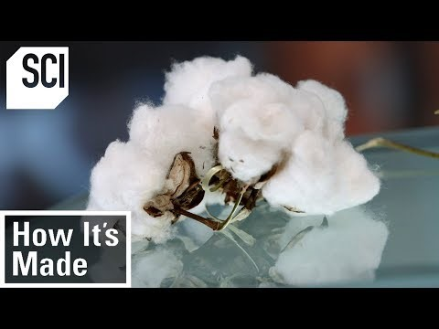
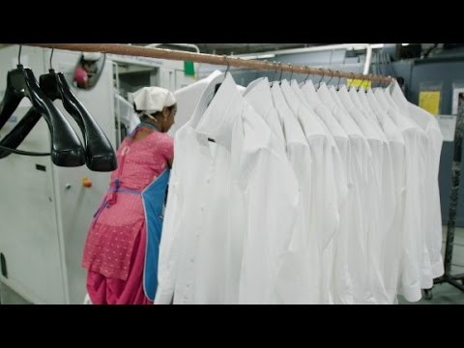
Cotton Production
Once you have read the fact sheet about cotton, you can use this link to watch a couple of short films about it.
Links: youtube.com/watch?v-QHgNoSYlhYs
Youtube.com/watch?v=lCy5DJb24_s

Slide 5
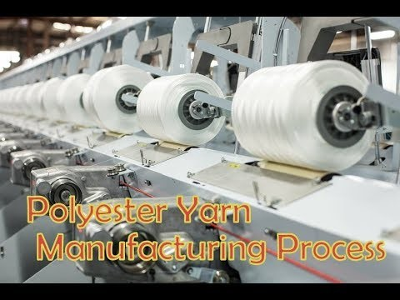
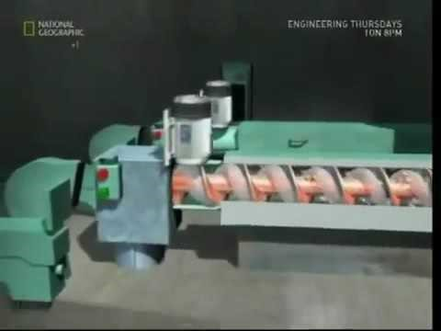
Polyester Production
Once you have read the fact sheet about polyester, you can use these links to watch a couple of short films about it.
Links: youtube.com/watch?v=fNdsOraykNi
Youtube.com/watch?v=zYkglUysDKk

Slide 6
Thoughts and Feelings
Positive
Negative
Happy
Joyful
Grateful
Intrigue
Hopeful
Proud
Fascinated
Secure
Ambitious
Determined
Sad
Anxious
Worried
Overwhelmed
Fear
Distracted
Anger
Hurt
Upset
Threatened

Slide 7
Self-Assessment
Use these prompts to reflect on your work and make any necessary corrections. At National Academy, we do this in green pen, use a green pen if you have one.
Every sentence needs a capital letter.
Names of people and places need capital letters.
Plurals don’t need apostrophes.
There – over there/there are/there was
Their – walk home on their own/their bags/in their experience
They’re – abbreviation of they are
Singular – I was /he was/she was Plural - we were/they were
Verbs – is the tense maintained? Check your verb endings ‘ed’ is past tense, ‘ing’ is present tense – are your verb endings consistent throughout your writing?

